Slide 1



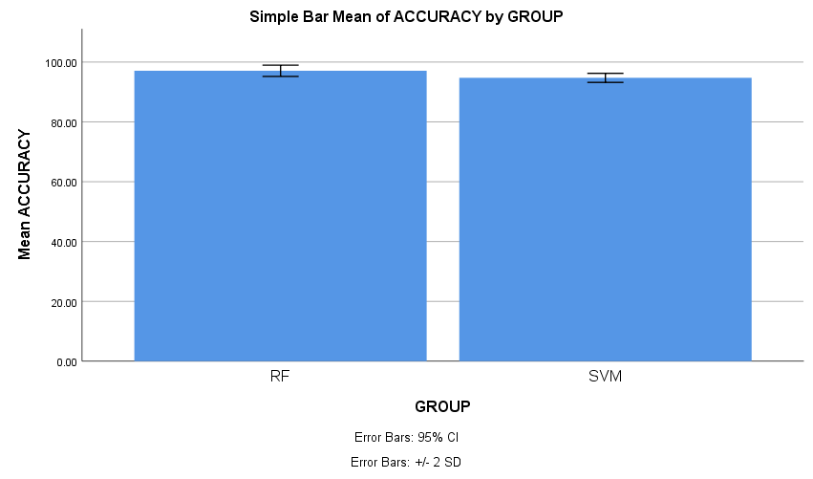
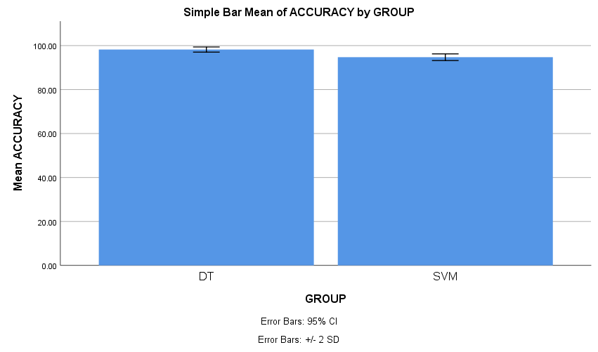


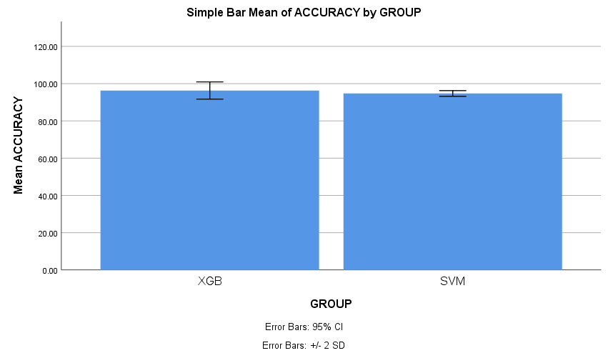
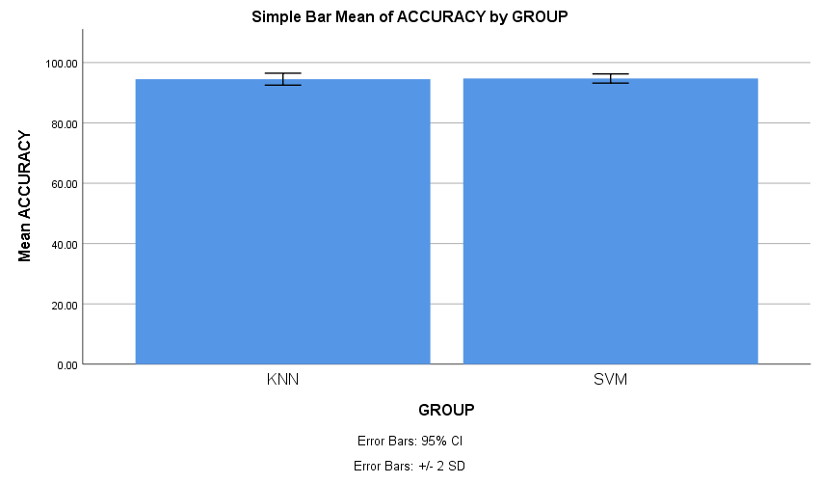
Register No: 192210314 Students Name: K.L.V Jayaram
Guided By Dr. A. Moorthy
Evaluating the precision of Random Forest vs Support Vector Machines for Forecasting Job Rescission in the Industry
A Comparative Analysis of Decision Tree and Support Vector Machines for Predicting Job Rescission in the Industry
INTRODUCTION
INTRODUCTION
Job rescission forecasting is vital for proactive workforce and economic planning.
Random Forest and Support Vector Machines (SVM) are two popular algorithms with distinct strengths.
This study investigates their precision in forecasting job rescission events within industry datasets.
Predicting job rescission is essential for talent retention and risk mitigation in industries.
This paper compares their efficiency in predicting job termination events using industry data.
Special focus is placed on interpretability, accuracy, and computational efficiency.
MATERIALS AND METHODS
Fig. 1.1 The Domino Effect of Layoffs
MATERIALS AND METHODS
Fig. 2.1 The Moment after Job Rescission
1.Load Dataset
2. Data Preprocessing
3. Train/Test Split (80/20)
1.Load Dataset
3.Train/
Test Split (80/20)
5.Model Evaluation
7. Optimal Prediction with Decision Tree
6.SPSS Analysis
Random Forest-97.07%
SVM-94.7%
5.Evaluate Accuracy
2.Data
Refinement
4. Model Training: Decision Tree, SVM
6. SPSS Analysis
Decision Tree:
98.3%
SVM: 94.72%
7. Best Accuracy with Random Forest
4.Model Training: Random Forest, SVM
RESULTS
RESULTS
Table-1.1 Mean Accuracy Values
Table 2.1 Mean Accuracy values
Group Statistics
Model | N | Mean | Std. Deviation | Std. Error Mean
Random Forest | 10 | 97.079 | 0.946 | 0.299
SVM | 10 | 94.720 | 0.760 | 0.240
Group Statistics
Model | N | Mean | Std. Deviation | Std. Error Mean
Decision Tree | 10 | 98.202 | 0.584 | 0.185
SVM | 10 | 94.720 | 0.760 | 0.240
Compared to SVM, Random Forest delivered better accuracy (97.07%) in predicting job rescission.
Fig. 1.2 SPSS Performance Analysis
Compared to SVM, Decision Tree delivered better accuracy (98.2%) in predicting job rescission.
Fig. 2.2 SPSS Performance Analysis
DISCUSSION AND CONCLUSION
DISCUSSION AND CONCLUSION
Random Forest achieved higher accuracy (97.07%) than Support Vector Machine (94.7%) in predicting job rescission.
Ensemble-based models like Random Forest are more suitable for complex labor market data. SVM showed difficulty in capturing nonlinear relationships in the rescission patterns.
SPSS analysis reveals a p-value of 0.001, indicating a statistically significant difference between group 1 and group 2.
In predicting the job rescission, Decision Tree proved more accurate than SVM, scoring 98.3% versus 94.72%.
SPSS analysis reveals a p-value of 0.001, indicating a statistically significant difference between group 1 and group 2.
Decision Tree, despite being simpler, delivered higher accuracy and required less tuning. For real-world deployment, Decision Trees offer transparency and reliability.
BIBLIOGRAPHY
BIBLIOGRAPHY
Kim, Kyungsu. 2025. “Unemployment Dynamics Forecasting with Machine Learning Regression Models.” arXiv preprint arXiv:2505.01933.
Frank, Morgan, Yong-Yeol Ahn, and Esteban Moro. 2023. “AI Exposure Predicts Unemployment Risk.” arXiv preprint arXiv:2308.02624.
Xu, Dawei, Haoran Yang, Marian-Andrei Rizoiu, and Guandong Xu. 2025. “From Occupations to Tasks: A New Perspective on Automatability Prediction Using BERT.” arXiv preprint arXiv:2502.09021.
Pontes, Elvys Linhares, Mohamed Benjannet, and Raymond Yung. 2024. “Forecasting Four Business Cycle Phases Using Machine Learning: A Case Study of US and EuroZone.” arXiv preprint arXiv:2405.17170.
Chen, Yue, Xingyi Andrew, and Salintip Supasanya. 2024. “CRISIS ALERT: Forecasting Stock Market Crisis Events Using Machine Learning Methods.” arXiv preprint arXiv:2401.06172.
Jiarui Zheng, Yaohao Fan and Jiawei Tian. 2023. “US Recession Prediction Using Statistical and Natural Language Processing Methods.” 19: 184–192.
Enhancing Job Rescission Forecasting: XGBoost vs Support Vector Machines Performance Evaluation
Assessing the Predictive Accuracy of K-Nearest Neighbour vs Support Vector Machines for Job Rescission Forecasting
INTRODUCTION
INTRODUCTION
With rapid industrial shifts, accurate job rescission prediction is becoming increasingly critical.
Gradient boosting methods like XGBoost have gained prominence for their strong predictive power.
This study evaluates XGBoost against SVM in forecasting employment discontinuities.
The study explores the use of instance-based vs margin-based algorithms for job rescission prediction.
K-Nearest Neighbour (KNN) and SVM are both standard classifiers with different learning paradigms.
The goal is to assess their accuracy in identifying potential job rescission cases in industry.
MATERIALS AND METHODS
Fig. 3.1 Final Walk after Rescission.
MATERIALS AND METHODS
Fig. 4.1 Job Searching due to Rescission
1.Load
Dataset
2.Data
Processing
3 Train/Test Split (80/20)
1.Load Dataset
2.Clean data
3. Train/Test Split (80/20)
4. Model Training KNN, SVM
7. Optimal Prediction with XGBoost
6. Model Accuracy KNN-95.5%
SVM-94.7%
5. Model Evaluation
4. Model Training KNN, SVM
5. Model Evaluation
6. Model Accuracy KNN-95.5%
SVM-94.7%
7. Optimal Prediction with KNN
RESULTS
RESULTS
Table 3.1 Mean Accuracy Values
Table 4.1 Mean Accuracy values
Group Statistics
Model | N | Mean | Std. Deviation | Std. Error Mean
XGB | 10 | 96.30 | 2.313 | 0.731
SVM | 10 | 94.72 | 0.760 | 0.024
Group Statistics
Model | N | Mean | Std. Deviation | Std. Error Mean
KNN | 10 | 95.50 | 0.985 | 0.311
SVM | 10 | 94.72 | 0.760 | 0.240
Compared to SVM, XGBoost delivered better accuracy (96.29%) in predicting job rescission.
Fig 3.2 SPSS Performance Analysis
Compared to SVM, KNN delivered better accuracy (95.5%) in predicting job rescission.
DISCUSSION AND CONCLUSION
DISCUSSION AND CONCLUSION
Fig. 4.2 SPSS Performance Analysis
XGBoost outperformed Support Vector Machine in predicting job rescission, achieving a higher mean accuracy of 96.3% compared to 94.72%.
SPSS analysis reveals a p-value of 0.001, indicating a statistically significant difference between group 1 and group 2.
XGBoost’s ability to handle missing values and class imbalance contributed to its success. Hyperparameter tuning of SVM showed minimal improvement in performance metrics.
KNN demonstrated superior accuracy (95.5%) over SVM (94.7%) in forecasting ideal post times.
Distance-based models like KNN can capture local trends better in employment data. SVM may be refined for use in controlled environments but is not optimal for rescission prediction.
SPSS analysis reveals a p-value of 0.001, indicating a statistically significant difference between group 1 and group 2.
BIBLIOGRAPHY
BIBLIOGRAPHY
Kim, Kyungsu. 2025. “Forecasting Labor Demand: Predicting JOLT Job Openings Using Deep Learning Model.” arXiv preprint arXiv:2503.19048.
Keenan, Vernon. 2025. “The White-Collar Recession of 2025: AI and the Great Professional Displacement.” SalesforceDevops.net.
Herschberg, Mark A. 2024. “The Coming AI Recession: Looking Over the Cliff of Technological-Based Job Loss.” Medium.
Using an Ensemble of Machine Learning Algorithms to Predict Economic Recession.” 2024. Journal of Risk and Financial Management 17(9): 387.
Xu, Nuo. 2024. “Use Machine Learning to Forecast Economic Recession with Covid-19 Evidence.” Journal of Applied Economics and Policy Studies 4: 34–43
Jiang, Xinyue. 2024. “Forecasting Urban Unemployment Rate in China Using ARIMA Model.” Theoretical and Natural Science 51: 142–148.
Grossman, Gary. 2025. “AI and the Next Recession.” InformationWeek.
Keenan, Vernon. 2025. “The White-Collar Recession of 2025: AI and the Great Professional Displacement.” SalesforceDevops.net.

